Slide 1



Sentiment & Exploratory Data Analysis of Tweets on COVID-19 Vaccines.
GROUP 5

Slide 2
Team Members
Suchit S Kakirde
Mohit K Dundu
Satya Teja Kasula
Koushik Peddi

Slide 3
CONTENTS
INTRODUCTION
DATA DESCRIPTION AND SOURCE
RESEARCH QUESTIONS
METHODOLOGY
RESULTS AND DISCUSSION
CONCLUSION

Slide 4

INTRODUCTION

Slide 5



Slide 6
Data Description and Source
Source
Source 1: Twitter Mining using Tweepy
Link
Link: https://www.kaggle.com/datasets/gpreda/all-covid19-vaccines-tweets?resource=download
Twitter
To access Twitter API, the data is collected using the Tweepy Python package with a search term for each vaccine
Source 2: Kaggle

Slide 7
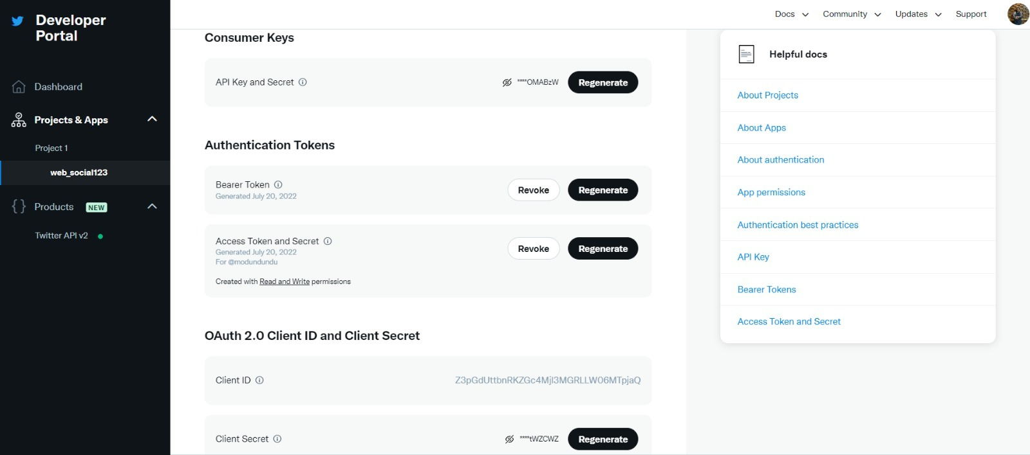
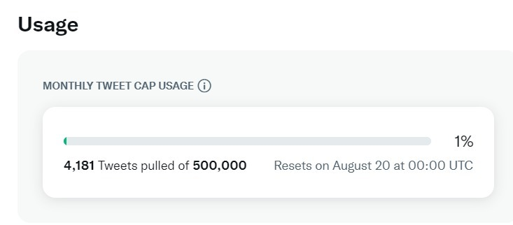
Data Authorization & Mining

Slide 8
No of tweets used for Analysis using Kaggle Data set – 228207
The initial data came from tweets about the Pfizer/BioNTech vaccine. Then there were tweets from Sinopharm, Sinovac, Moderna, Oxford/Astra-Zeneca, Covaxin, and Sputnik V vaccines added. The collection was twice a day in the beginning, until the Author approximated the new tweets quota, and then collection (for all vaccines) stabilized at once a day, during the morning hours (GMT).
Attributes:- Id, user_name, user_location, user_description, user_created, user_followers, user_friends, user_favourites, user_verified, date, text, hashtags, source, retweets, favorites, is_retweet.
No of tweets used for Analysis using Twitter Mining - 4181

Slide 9

Research Questions

Slide 10
1. What is sentiment analysis? 2. What is Exploratory Data Analysis? 3. How does social media influence them?

Slide 11
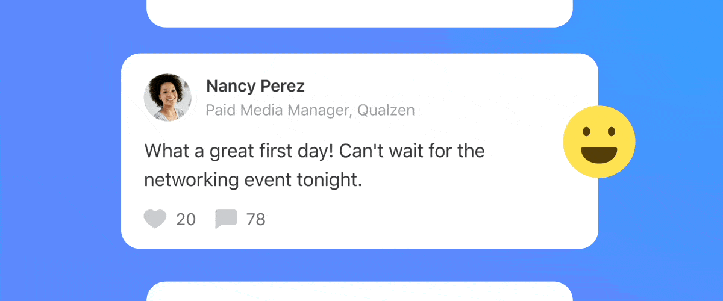
SENTIMENT ANALYSIS

Slide 12

EXPLORATORY DATA ANALYSIS
(EDA) is best described as a method for discovering patterns, detecting anomalies or differences, and identifying other features that best summarize the main characteristics of a data set.
Exploratory Data Analysis is ‘a philosophy’ towards how the data is to be analyzed.

Slide 13
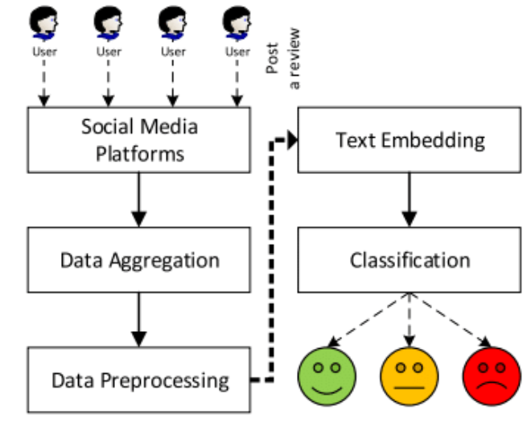
INFLUENCE OF SOCIAL MEDIA ON ANALYSIS

Slide 14
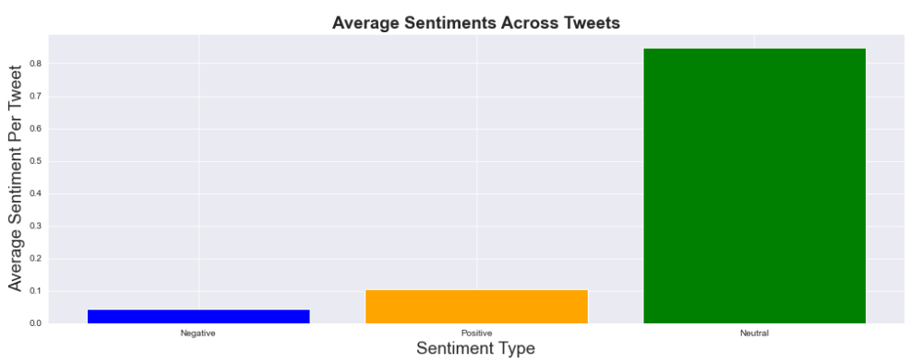
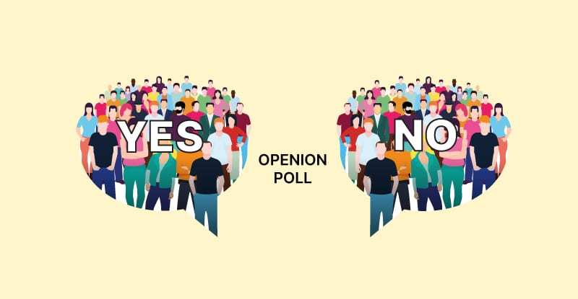
How do people perceive Covid 19 vaccine? Whether a positive or a negative opinion?

Slide 15


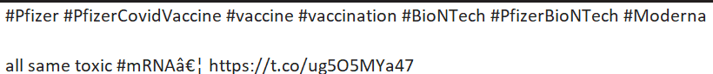
What is impacts of tweets on vaccines in real time?
Reluctance increased.
Bad publicity.
Defamation of vaccines companies.

Slide 16
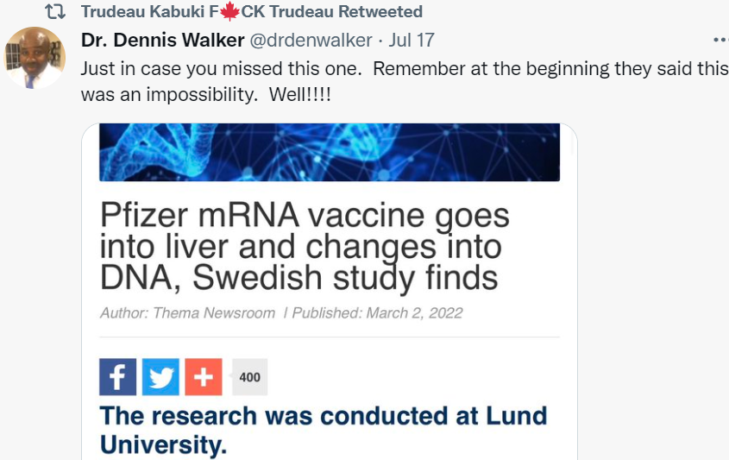
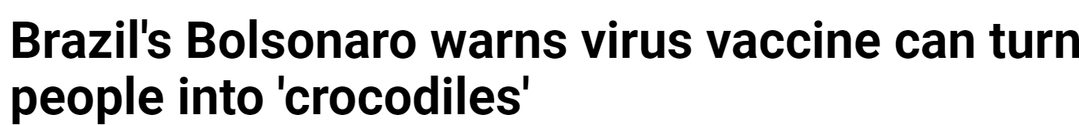
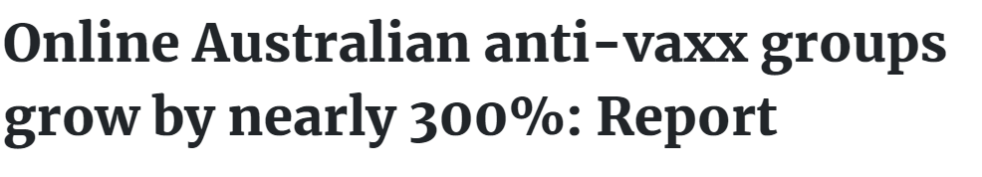
Are the tweets influencing people in any way to accept or reject vaccine?
Location : Canada
Location : Brazil
Location : Australia

Slide 17
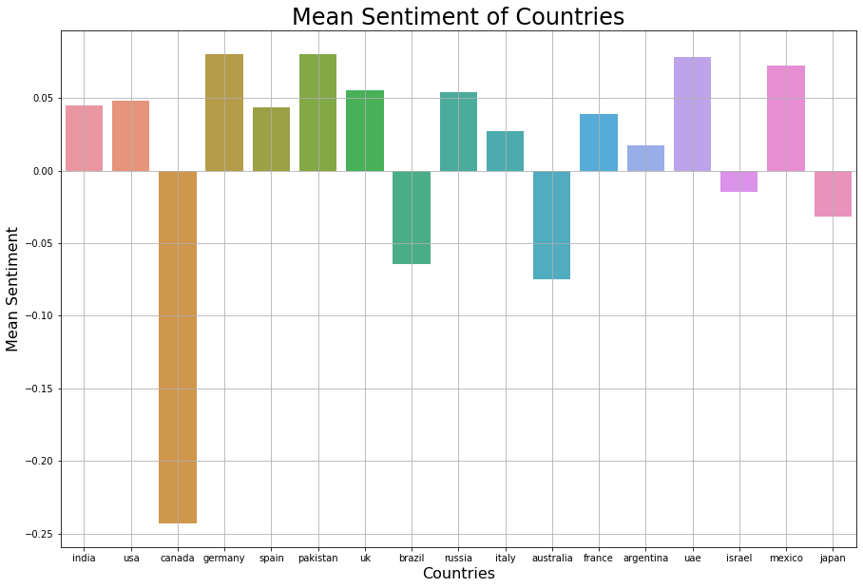
END RESULT.

Slide 18


METHODOLOGY

Slide 19

STEP BY STEP METHODOLOGY
DATA PRE- PROCESSING AND UNDERSTANDING
TEXT PROCESSING
SENTIMENT ANALYSIS
TEXTBLOB
Regression Analysis

Slide 20
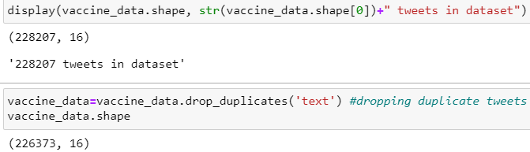
DATA PRE-PROCESSING AND UNDERSTANDING
Total tweets before and after removal of duplicates.

Slide 21
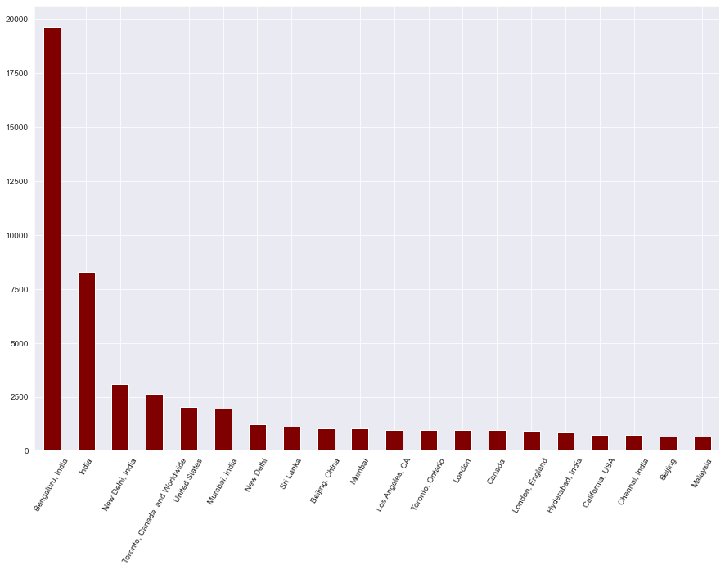
DATA PRE-PROCESSING AND UNDERSTANDING contd (1)
Visualizing Tweet Count vs Location
Understanding is importance of tweet source is equally important

Slide 22
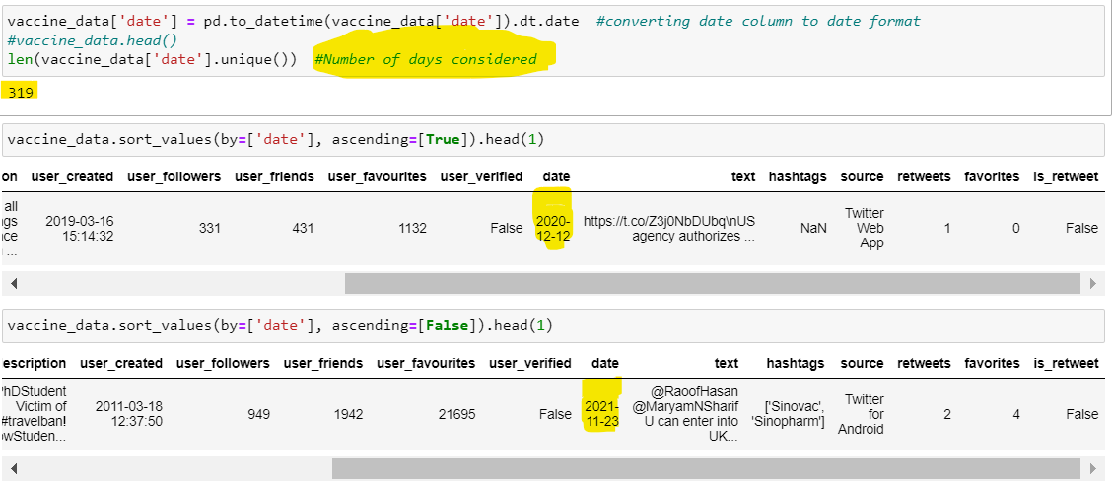
DATA PRE-PROCESSING AND UNDERSTANDING contd. (2)
Data timeline

Slide 23
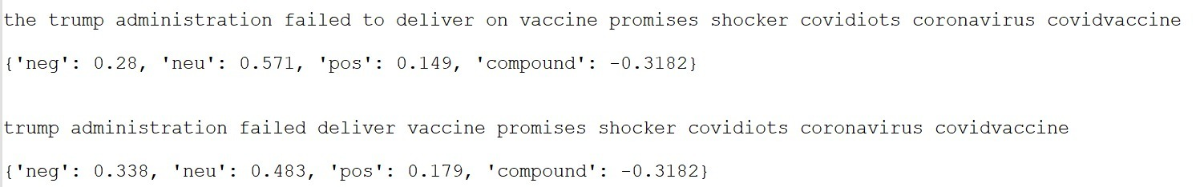
TEXT PROCESSING - STEPS
STEP 1
Converting into lowercase
STEP 2
Remove URL
STEP 3
Remove Punctuation
STEP 4
Single character and double space removal.
STEP 5
Stop word Removal
STEP 6
Emoji Removal

Slide 24
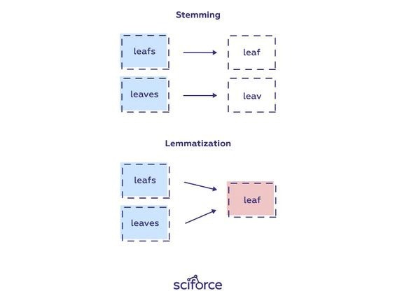
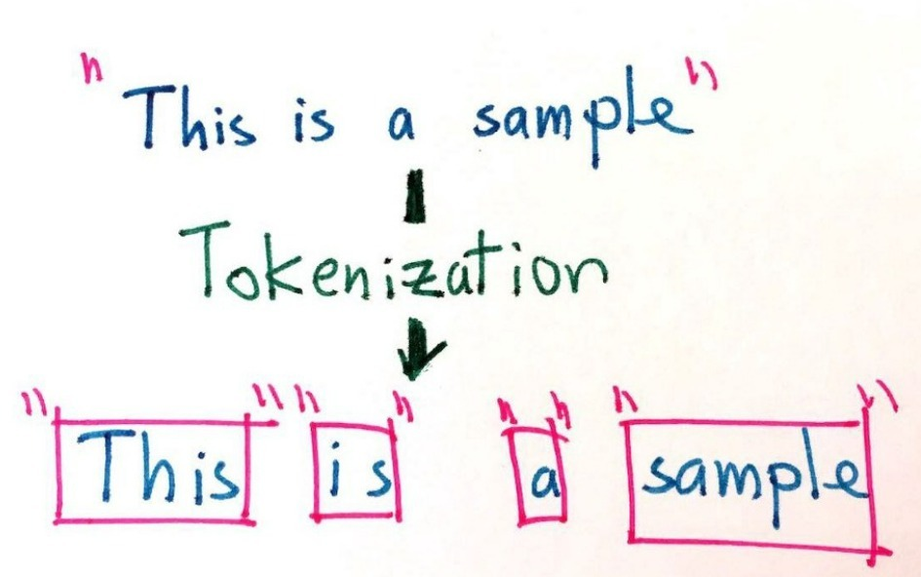
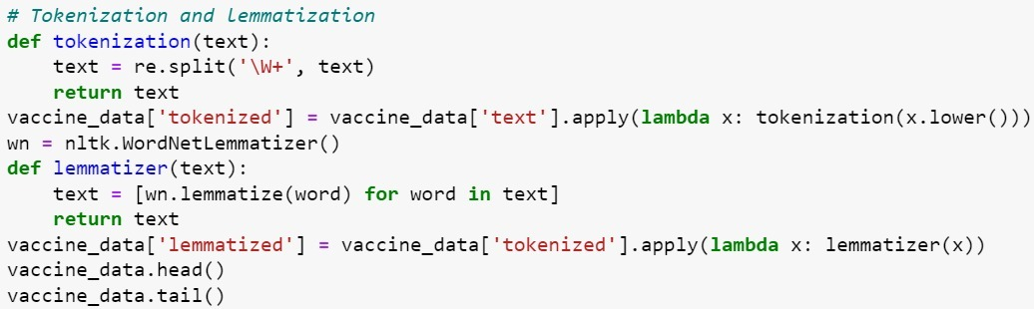
TOKENIZATION & LEMMATIZATION
TOKENIZED –
['deaths', 'closing', '300000', 'mark', 'millions', 'people', 'wait', 'pfizerbiontech', 'vaccine', 'first']
LEMMATIZED –
['death', 'closing', '300000', 'mark', 'million', 'people', 'wait', 'pfizerbiontech', 'vaccine', 'first']

Slide 25

Sentiment Analysis using VADER
VADER ( Valence Aware Dictionary for Sentiment Reasoning) is a model used for text sentiment analysis that is sensitive to both polarity (positive/negative) and subjectivity of emotion.
As we are aware that the maximum length of a tweet is 140 characters. Vader stands as the best model. As, VADER is more effective for short length texts.
There are other models/libraries available for sentiment analysis but Vader is best suited for social media because it is smart enough to ignore grammatical formation of sentences, especially in social media context.
The main drawback of these models is that they are unable to understand the context in which words have been used
With this we will be adding a new column ‘Sentiment’ To the data set.

Slide 26
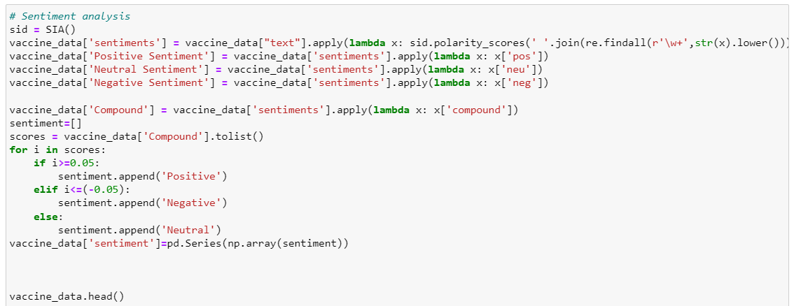
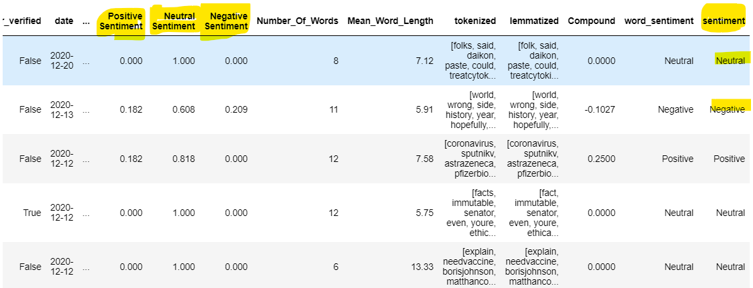
Sentiment Analysis using VADER contd..

Slide 27
TEXTBLOB
TextBlob is a Python library for processing textual data.
It provides a simple API for diving into common natural language processing (NLP) tasks such as part-of-speech tagging, noun phrase extraction, sentiment analysis, classification, translation, and more.

Slide 28
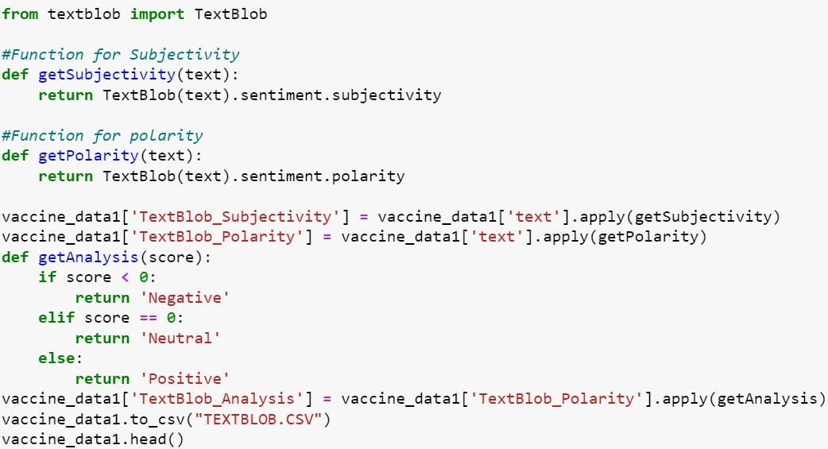
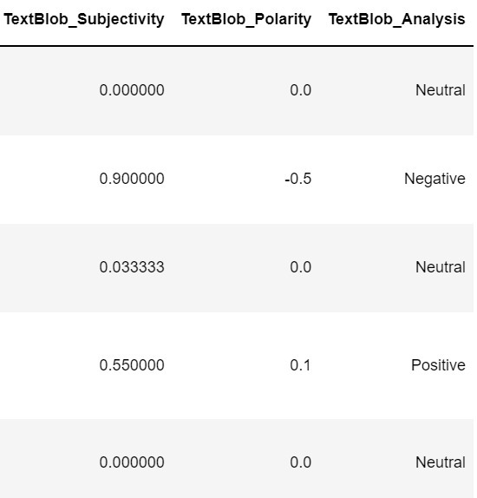
TEXT Blob contd..

Slide 29
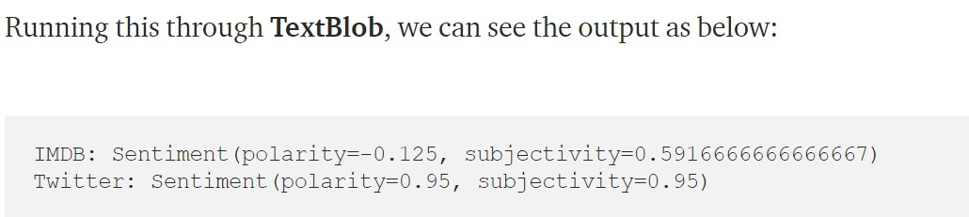
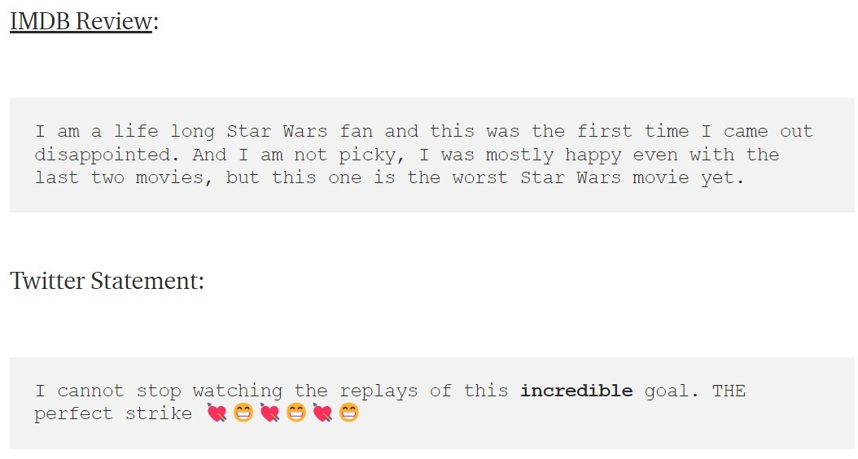
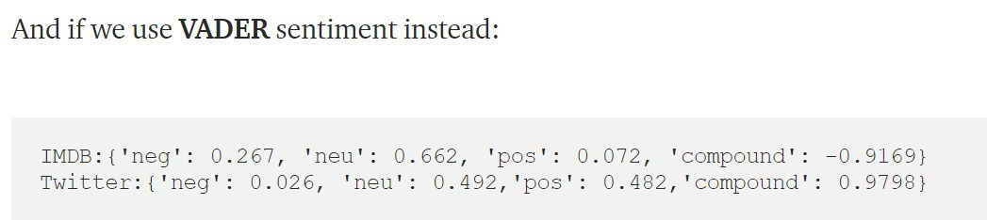
TEXTBLoB vs VADER

Slide 30
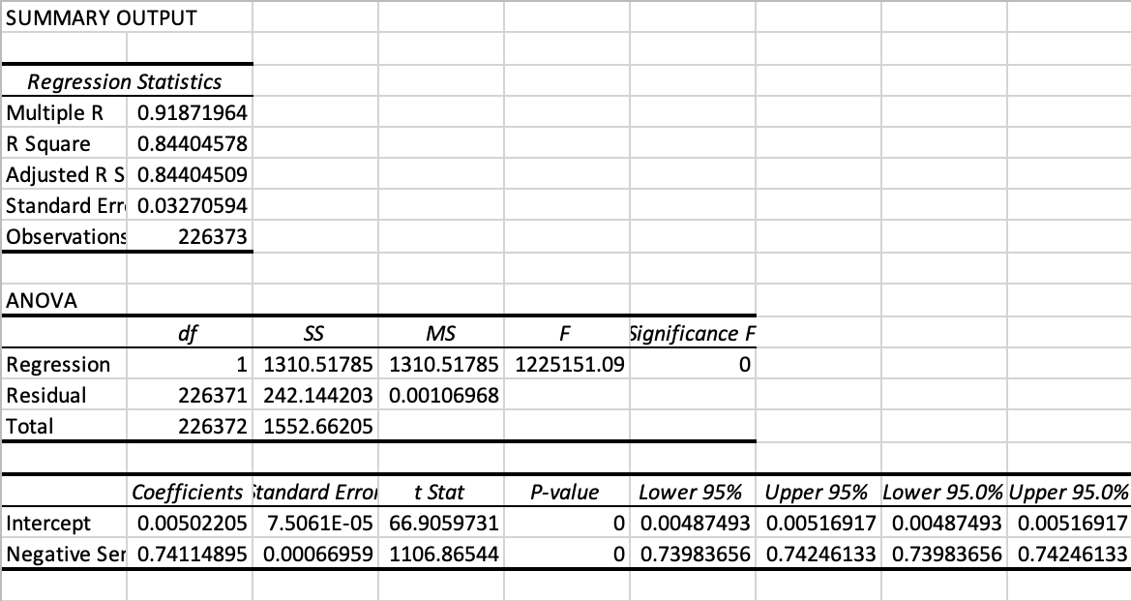
Regression Analysis- TextBLoB

Slide 31
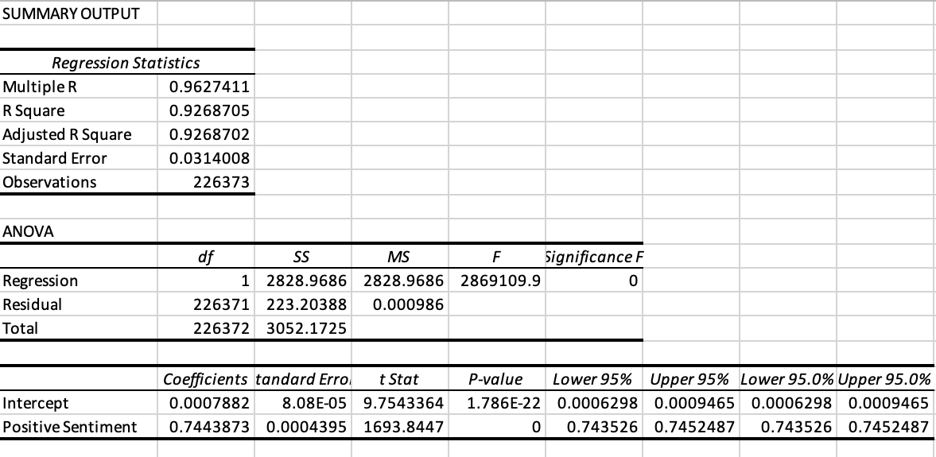
Regression Analysis- VADER

Slide 32
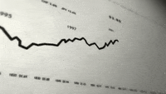
RESULTS & DISCUSSIONS

Slide 33
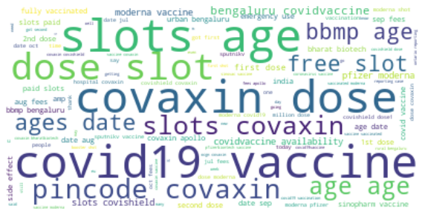
Word cloud for Most frequent words
Using Kaggle Data set

Slide 34
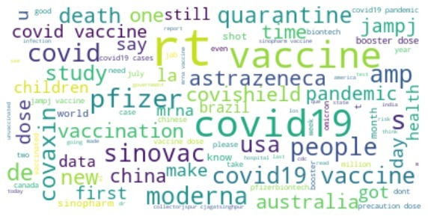
Word cloud for Most frequent words
Using own Data set

Slide 35
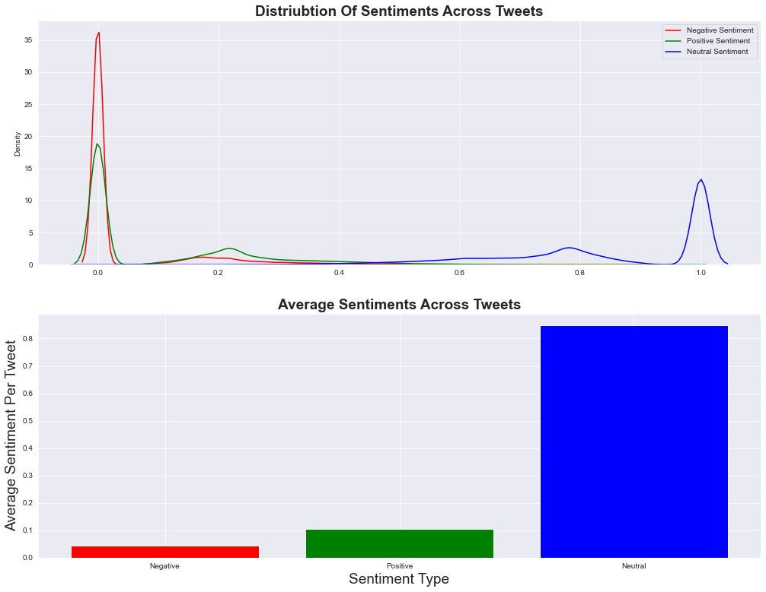
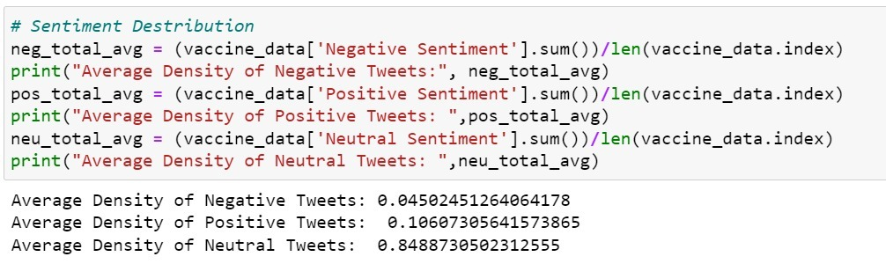
SENTIMENT DISTRIBUTION

Slide 36
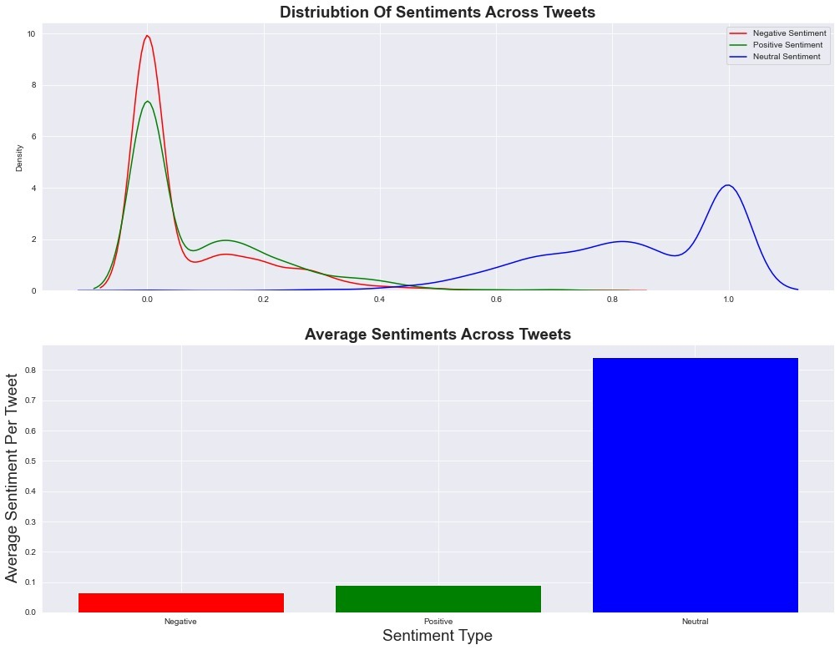
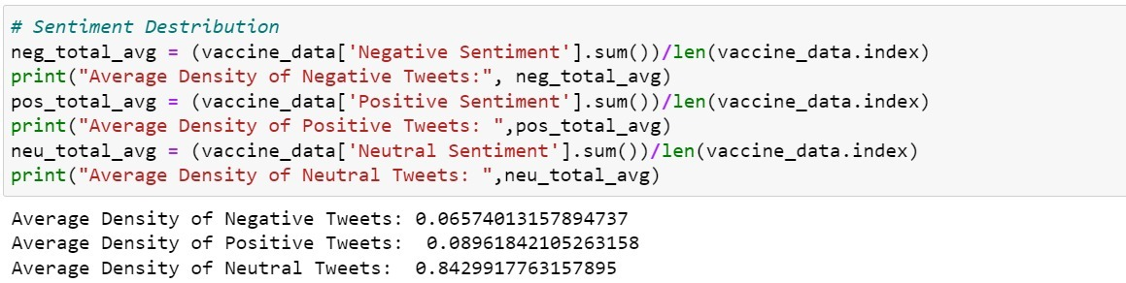
SENTIMENT DISTRIBUTION

Slide 37
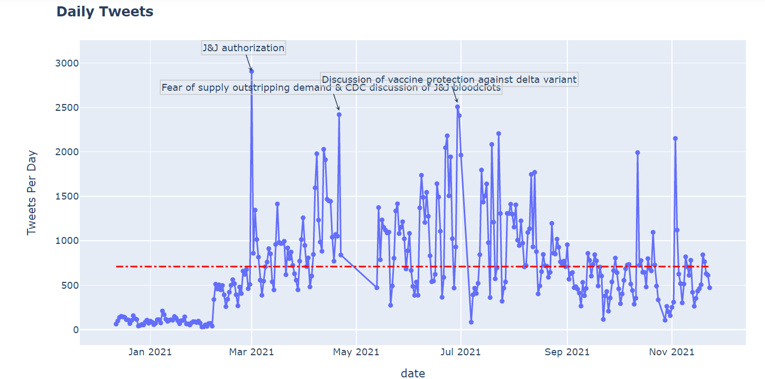

DAILY TWEETS VISUALIZATION

Slide 38
Subjectivity & Polarity
Polarity refers to the orientation of an emotion expressed in a sentence. It can be either positive, negative, or neutral.
When text is an explanatory article that must be analyzed in context, it is said to be subjective.

Slide 39
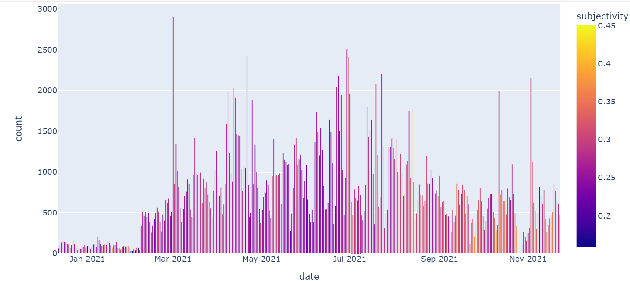
SUBJECTIVITY

Slide 40
POLARITY

Slide 41

TREE MAPPING

Slide 42
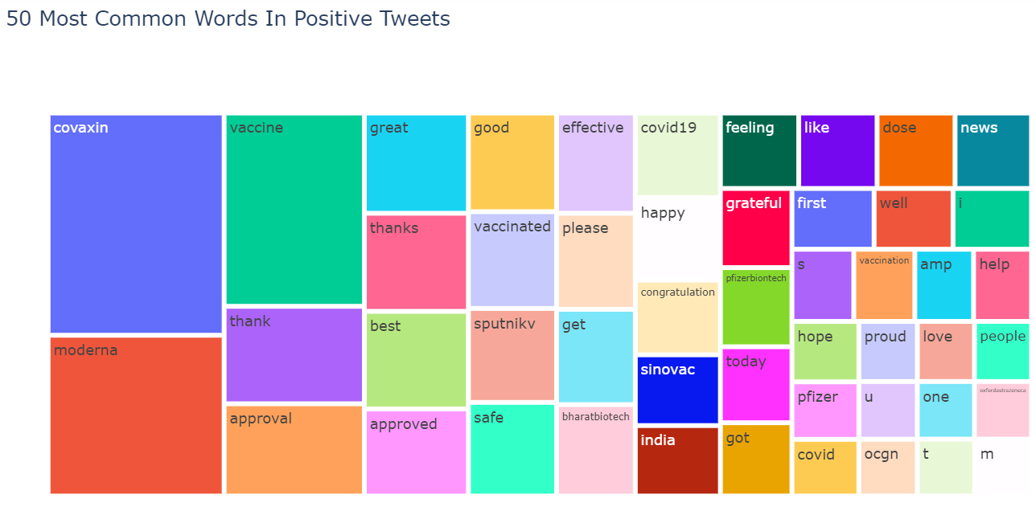
USING KAGGLE DATA SET

Slide 43
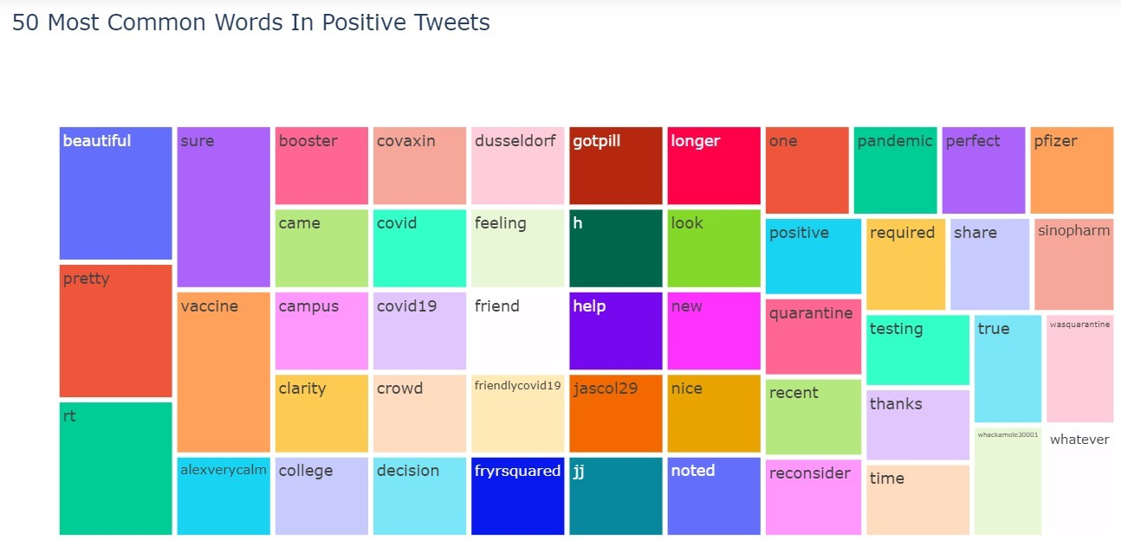
USING OWN DATA SET

Slide 44
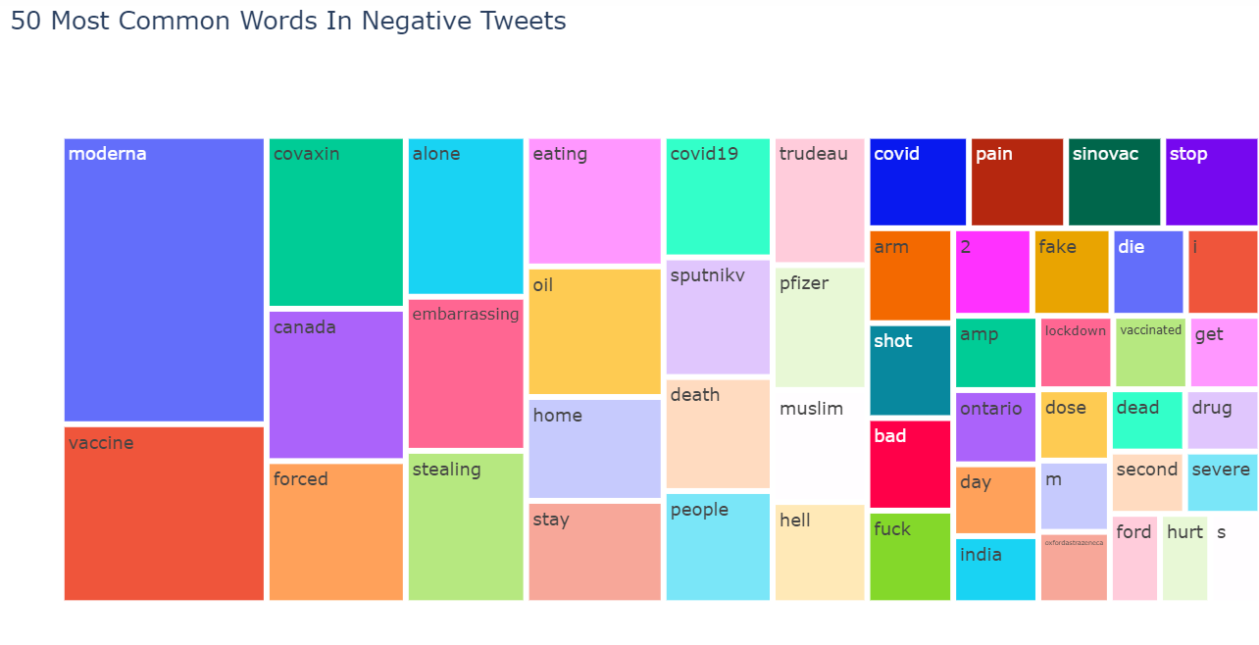
USING KAGGLE DATA SET

Slide 45
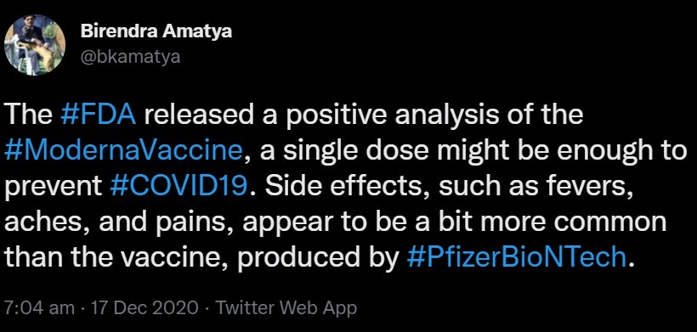
What’s wrong with #Moderna ?

Slide 46
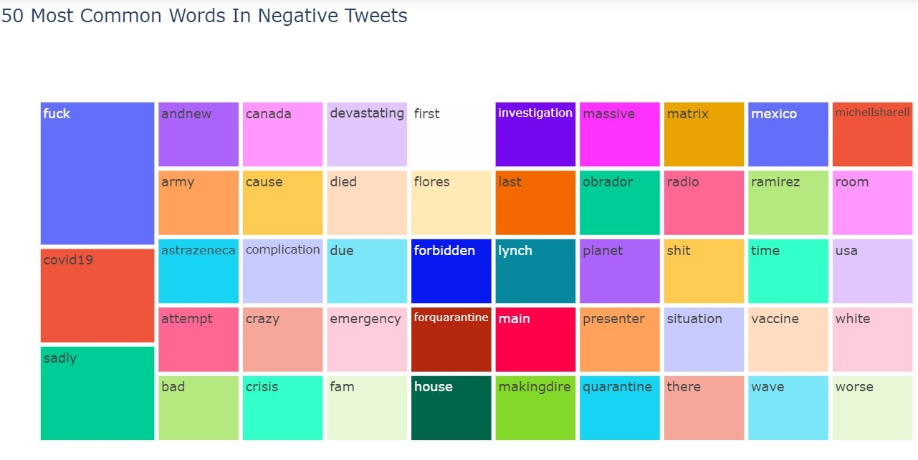
USING OWN DATA SET

Slide 47

SOME INTRESTING STATISTICS!

Slide 48
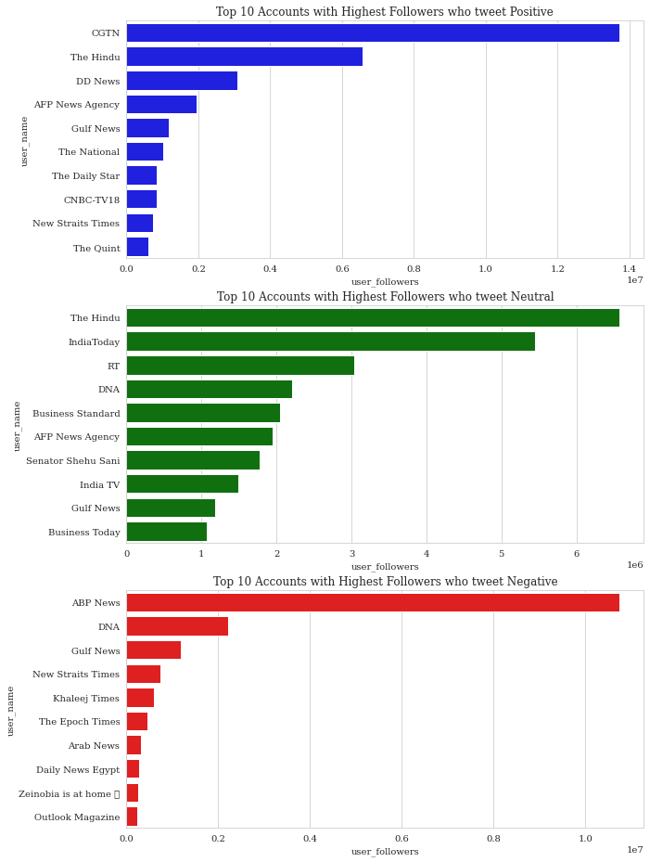

Slide 49
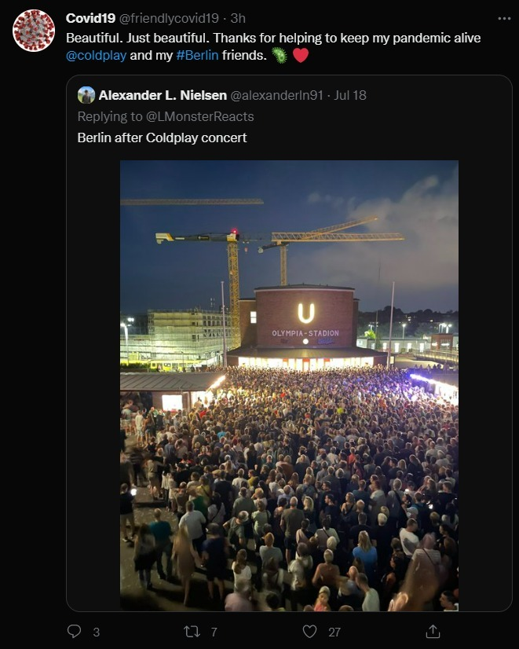
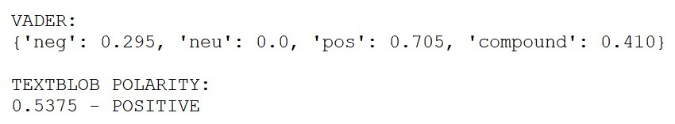
DRAWBACKS OF TEXT ANALYSIS

Slide 50
CONCLUSION
Through our understanding we can conclude that there is a lot of scope for the improvement, despite of inaccuracy to the match with human intel.
In today’s scenario influencer have the capacity to drive the sentiments of the common man with the help of social media.
Good or Bad, Every opinion matters.
In future, corporations and small businesses can also benefit through such analyses and machine learning models to better understand consumer sentiment and expectations.

Slide 51

MAY THE DATA BE WITH YOU.

